Slide 1
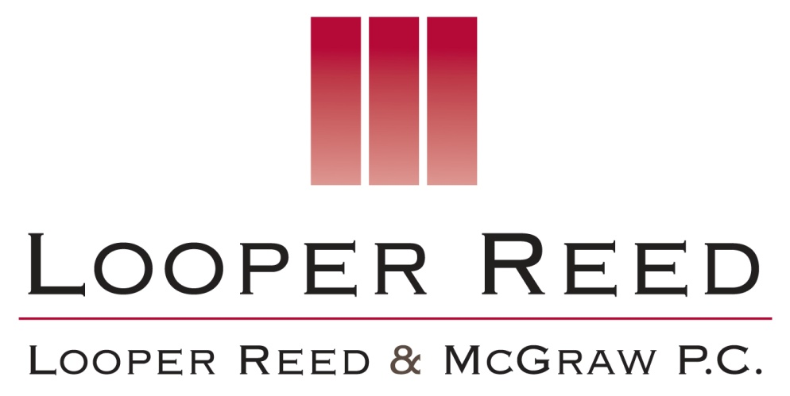
YOUR FAULT, MY FAULT, THEIR FAULT … DOES IT EVEN MATTER? INDEMNIFICATION AND EXCULPATORY AGREEMENTS IN THE OIL PATCH
2013 AAPL Southwest Land Institute -- Dallas
April 30, 2013
Charles W. Sartain J. Wayne Ballew Robert Slater
cwsartain@lrmlaw.com jwballew@lrmlaw.com rslater@lrmlaw.com
Web: www.lrmlaw.com Blog: www.energyandthelaw.com
1601 Elm Street, Suite 4600 1300 Post Oak Blvd., Suite 2000 100 E. Ferguson St., Suite 614
Dallas, TX 75201 Houston, Texas 77056 Tyler, Texas 75702 TEL: 214.237.6365 TEL: 713.986.7000 TEL: 903.594.4381

Slide 2
“Every time a lawyer writes something, he is not writing for posterity. He is writing so endless others of his craft can make a living out of trying to figure out what he said. Course perhaps he hadn’t really said anything, that’s what makes it hard to explain.” Will Rogers.

Slide 3
The Indemnity Provision
“Plain English” Definition: An undertaking by which the indemnifying party (“indemnitor”) agrees to make good any loss or damage that the indemnified party (“indemnitee”) has incurred, or to safeguard the indemnitee against liability.

Slide 4
Why do we have indemnities? To allocate risk and create certainty.

Slide 5
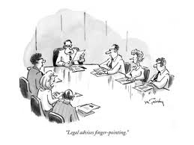

Slide 6
Scope of the Indemnity
Liability vs. Loss:
What is covered by the indemnity? Is an indemnitor’s obligation triggered by a “claim” of damage or when the “actual” damage determined?
Liability: An indemnity against liability obligates the indemnitor to protect the indemnitee from a loss or the cause of a loss. The right to recover on an indemnity against liability accrues when the liability becomes fixed and certain, regardless of whether the indemnitee has suffered an actual loss.
Example: A indemnifies B from claims arising from the acts or omissions of A.
Loss: A contract against loss or damage obligates the indemnitor to reimburse the indemnitee for amounts actually paid. The right to recover on an indemnity against loss accrues only upon the indemnitee’s actual payment of damages. In other words, the indemnity is a reimbursement.
Example: A indemnifies B from loss or damage suffered by B as the result of the acts or omissions of A.

Slide 7
Entity vs. Group:
Who is covered by the indemnity? To whom have the parties contractually agreed to extend the indemnity protection?
Entity: A contract of indemnity in favor of an individual entity obligates the indemnitor to protect only that entity from liability or loss.
Example: A indemnifies B from claims arising from the acts or omissions of A.
Group: A contract of indemnity in favor of a defined group obligates the indemnitor to protect all members of that group from liability or loss.
Example: A indemnifies B and B’s parent, subsidiaries, affiliates, partners, co-owners, joint interest owners, contractors, subcontractors and all of their respective agents, officers, directors, employees, and representatives from claims arising from the acts or omissions of A.

Slide 8
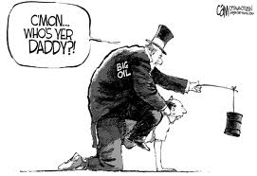

Slide 9
Oil and Gas Lease:
“Lessee agrees to indemnify, protect and hold Lessor harmless of and from any and all claims, demands, costs (including but not limited to attorney and expert fees), expenses, damages, losses, causes of action or suits for damages for injury to persons (including death) and injury or damage to or loss of any property or improvements caused by the operations upon the Leases Premises or Land pooled therewith. This obligation of Lessee shall apply regardless of cause or fault, including, without limitation, any negligent act or omission of Lessor, Lessor’s representatives, agents or employees.”
regardless of cause or fault,

Slide 10
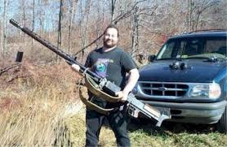
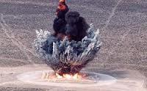

Slide 11
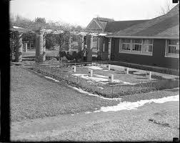
Prize Cow
Prize Cow Cemetery

Slide 12
Real Cow

Slide 13
Scenario 1:
Deer Hunter decides to use Lessee’s oil tank as his hunting “blind.” Overcome with “buck fever,” Deer Hunter takes aim, fires…and Lessee’s oil tank explodes. Deer Hunter is killed; all of Lessee’s surface facilities are destroyed; Lessee’s well is shut-in; and Lessor’s Hereford bull (on loan from Neighbor) is killed.
Deer Hunter’s family sues Lessor, seeking damages from Lessor arising out of Deer Hunter’s death.
Neighbor sues Lessor, and recovers damages from Lessor arising out of Hereford bull’s death.

Slide 14
What is the result?
As between Lessor and Lessee, Lessee owes indemnity to Lessor for both the injury to Deer Hunter and the damage to Neighbor assuming that the losses are “caused by the operations.”
[Note that Deer Hunter’s actions are not “operations,” but the explosions are the result of Lessee’s operations.]

Slide 15
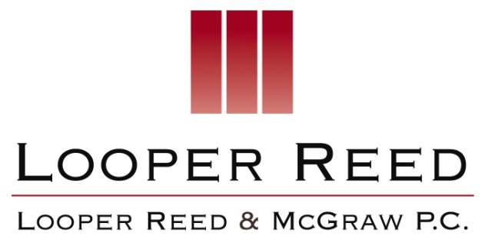
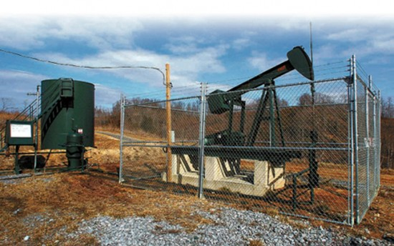
Contractor 1
(Drilling)
Lessee/Non-Operator
Contractor 2
(Frac)
Lessee/Operator
Subcontractor 1
Lessor
Employees
Subcontractor 2
Employees
Neighbor
and so on . . .
Employees
Well No. 1H
Regulatory 1
Regulatory 2

Slide 16
Master Service Agreement
“6.1 Liability of Contractor. Contractor shall Indemnify Company Group against all Claims arising out of or related to: (i) illness, bodily injury or death suffered by any member of Contractor Group; or (ii) property loss or damage suffered by any member of Contractor Group (including property owned, leased, hired or chartered) EVEN IF CAUSED BY THE FAULT OF COMPANY GROUP.
6.2 Liability of Company. Company shall Indemnify Contractor Group against all Claims arising out of or related to: (i) illness, bodily injury or death suffered by any member of Company Group; or (ii) property loss or damage suffered by any member of Company Group (including property owned, leased, hired or chartered) EVEN IF CAUSED BY THE FAULT OF CONTRACTOR GROUP.

Slide 17
6.3 Third Party Liability. Contractor shall Indemnify Company Group against all Claims arising out of illness, bodily injury, death, property loss or damage suffered by Third Parties, to the extent attributable to the Fault of Contractor. Likewise, Company shall Indemnify Contractor Group against all Claims arising out of illness, bodily injury, death, property loss or damage suffered by Third Parties, to the extent attributable to the Fault of Company.
Fault
of Contractor.
Fault of
Company.

Slide 18
6.4 Pollution. Subject to Section 6.1 and 6.2, Company shall Indemnify Contractor Group against all Claims for loss of or damage to property on account of an unauthorized release or discharge (including, but not limited to, any spilling, leaking, pumping, pouring, mining, emptying, injecting, escaping, leaching, dumping, or disposing into the environment) of any substance, material, compound, mixture, pollutant, or contaminant, which arises out of or is connected to Company Group’s activities connected to this Agreement. Likewise, subject to Section 6.1 and 6.2, Contractor shall Indemnify Company Group against all Claims for loss of or damage to property on account of an unauthorized release or discharge (including, but not limited to, any spilling, leaking, pumping, pouring, mining, emptying, injecting, escaping, leaching, dumping, or disposing into the environment) of any substance, material, compound, mixture, pollutant, or contaminant, which arises out of or is connected to Contractor Group’s activities connected to this Agreement.”
Company Group’s
activities
Contractor Group’s activities

Slide 19
Scenario 2:
Operator retains Contractor to conduct a fracture stimulation treatment on a well located on the Lease. The frac does not go as planned. The wellbore is lost. The casing fails, and the frac enters fresh water-bearing strata. Use of Lessor’s water well is lost.
Lessor sues Lessee/Operator, seeking damages for loss of use, and contamination, of Lessor’s water well.
TCEQ assess fines against Lessee/Operator as a result of the failed casing and fresh-water bearing contamination.
Lessee tenders an indemnity claim under the MSA, requesting Contractor’s indemnity (reimbursement/payment) of the damages suffered by Lessee/Operator and Lessor.

Slide 20
What is the result?
As between Operator and Contractor, damage to the wellbore and casing is Operator’s property, and therefore Operator is liable and cannot tender indemnity to Contractor.
As between Operator and Lessor, damage to the water well is damage to Lessor’s “property and improvements” under the Lease, and therefore Operator is liable.
As between Operator and Contractor, damage to the water well is damage to “property of Company Group” and therefore Operator is liable and cannot tender indemnity to Contractor.
As between Operator and Contractor, Operator will argue that TCEQ fines resulted from Contractor’s negligence, and Operator will try to recover these costs from Contractor.

Slide 21
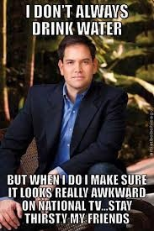

Slide 22
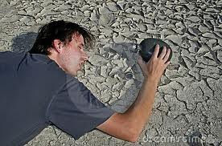

Slide 23
Scenario 3:
In addition to the facts set forth in Scenario 1, Neighbor drinks contaminated water from Lessor’s water well and contracts an incurable illness.
Neighbor sues Lessor, Lessee/Operator and Contractor, seeking damages.
Lessor tenders an indemnity claim to Lessee under the Lease. Lessee/Operator tenders an indemnity claim to Contractor under the MSA. Contractor tenders an indemnity claim to Lessee/Operator under the MSA.

Slide 24
What is the result?
As between Operator and Lessor, Operator is liable for Neighbor’s personal injury under the Lease. [Note: there may be an issue whether the injury was caused by the operations].
As between Operator and Contractor, Neighbor’s injury is an injury to a “Third Party,” and therefore liability is allocated based on the proportionate fault of each party.

Slide 25
Scenario 4:
Instead of Scenario 2, a Contractor’s frac crew employee drinks contaminated water from Lessor’s water well and contracts an incurable illness.
Employee sues Lessor, Lessee/Operator and Contractor, seeking damages.
Lessor tenders an indemnity claim to Lessee under the Lease. Lessee/Operator tenders an indemnity claim to Contractor under the MSA. Contractor tenders an indemnity claim to Lessee/Operator under the MSA.

Slide 26
What is the result?
As between Operator and Lessor, Operator is liable for Employee’s personal injury under the Lease.
[Note: there may be an issue whether the injury was caused by the operations].
As between Operator and Contractor, Employee’s injury is an injury to a member of “Contractor Group” and therefore Contractor is liable and Company may tender indemnity to Contractor.

Slide 27
Takeaway: What does this mean?
Under a lease with an indemnity, lessee/operator assumes broad liability for all damages regardless of fault.
Under a “standard” MSA, the operator and the contractor each assume broad liability for their respective people and property, regardless of fault, under a knock for knock indemnity.
The operator, as the common dominator contracting party, must be conscious of how its indemnity obligations fit together and how much liability it is assuming.
The industry has worked hard to inject certainty by allocating risk on the basis of ownership of the people and property involved, as opposed to legal fault, certainty has not been achieved in all cases.

Slide 28
What is an Exculpatory Clause?
Texas Supreme Court: A “clause in a contract designed to relieve one party of liability to the other for specified injury or loss incurred in the performance of the contract.”

Slide 29
The Model Form JOA
The 1956 AAPL Model Form 610 Onshore Operating Agreement:
5. Operator shall conduct all such operations in a good and workmanlike manner, but is shall have no liability as Operator to the other parties for losses sustained, or liabilities incurred, except such as may result from gross negligence or from breach of the provisions of this agreement.
The 1977 Model Form :
V.A. Operator . . . shall conduct and direct and have full control of all operations on the Contract Area . . . . It shall conduct all such operations in a good and workmanlike manner, but it shall have no liability as Operator to the other parties for losses sustained or liabilities incurred, except such as may result from gross negligence or willful misconduct.

Slide 30
The 1982 Model Form:
Operator … shall conduct all such operations in a good and workmanlike manner, but in no event shall it have any liability as Operator to the other parties for losses sustained or liabilities incurred, except such as may result from gross negligence or willful misconduct.
The 1989 Model Form:
Operator shall conduct its activities under this agreement as a reasonably prudent operator, in a good and workmanlike manner, with due diligence and dispatch, in accordance with good oilfield practice, and in compliance with applicable law and regulation, but in no event shall it have any liability as Operator to the other parties for losses sustained or liabilities incurred except such as may result from gross negligence or willful misconduct.
such operations
its activities

Slide 31
Scenario 5 (1989 Form):
Two oil bearing formations, the Upper and the Lower. Production from the Upper held leases as to all depths. Parties attempted to recomplete in the Lower formation.
Production anywhere = production from all tracts. The Lower was not unitized.
Operator failed to conduct RRC-required tests. Two of the wells showed excessive fluid levels,
Operator did not retest, repair, or attempt to plug those wells. RRC severed the Upper Unit and suspended production = loss of leases.

Slide 32
Operator: As Operator he had the exclusive right of possession of certain well bores.
Non-operators: Counterclaimed for illegally produced oil, fraudulent reporting oil from one formation as being produced from another, failure to sustain production in the quantities required by the JOA.
Only gross negligence or willful misconduct were actionable for both operational and administrative claims against. The court examined Operator’s conduct: “No evidence that Operator knew about the peril but did not care about the consequences.”

Slide 33
Scenario 6 (1977 Form):
Operator drills three wells. Non-Operator assumes operations and drills additional wells. Disputes arise about operations.
New Operator plugs wells despite Non-Operator’s desire to take them over. Non-Operator claims Operator withheld information, preventing Non-Operator from making informed decisions. Non-Operator also claims tortuous interference.
Non-Operator’s theory: Exculpatory clause should not excuse an Operator’s liability for non-physical acts such as administrative and accounting duties and recovery of costs (breaches of the JOA).
Exculpatory clause was clear and unambiguous; Non-Operator could not recover for acts as Operator, such as “the completion, testing or turnover” of the well absent gross negligence or intentional misconduct. Stine v. Marathon Oil Company.

Slide 34
Scenario 7 (1977 Form):
Operator sends AFE for “reworking operations” and asks for election. Non-Operators claim operations are routine.
Unjustified AFE may constitute breach of the JOA. Operator relies on the exculpatory clause; no liability except for acts of gross negligence or intentional misconduct.
Exculpatory clause is unambiguous. The scope of protection extends only to claims that Operator failed to act as a reasonable and prudent operator, not claims for breach.
AFE was not justified because the operations were not “reworking”. Abraxas Petroleum Corp. v. Hornburg.

Slide 35
What does all this mean?
You never know what to expect at the courthouse.
What court you are in matters.
The precise language of the contract makes a difference.
“Boilerplate” has meaning.
Abraxas is still good law if the 1977 form is used AND you are in state court: “its activities” vs. “all such operations”.

Slide 36
Scenario 8:
Operator and Non-Operator each own a 50% WI in Lease; JOA has exculpatory language. They conduct workover on an existing well. The Operator hires Contractor to perform the frac. Workover operation fails and ruins the well. The well must be P&A’ed. Employee of the Contractor is injured and claims his injuries resulted from the Operator’s negligent supervision.
Lessor sues Operator and Non-Operator, and recovers damages.
Contractor employee sues Contractor, Operator and Non-Operator, and recovers damages.
Operator tenders indemnity to Contractor for damages paid to Lessor, alleging Contractor gross negligence.

Slide 37
Operator invoices Non-Operator for its share of damages paid.
Operator tenders indemnity to Contractor for damages paid to Contractor Employee.
Non-Operator sues Operator to avoid payment of its proportionate share of the damages. Operator asserts the exculpatory clause as a defense.

Slide 38
What is the result?
Between Operator, Non-Operator and Lessor: Operator and Non-Operator are liable for damage to Lessor’s “property and improvements” under the Lease, and therefore Operator is liable.
Between Operator, Non-Operator and Contractor: Employee’s injury is to a member of “Contractor Group”; Contractor is liable and Company may tender indemnity to Contractor on its behalf and that Non-Operator.
Is the Operator protected? Yes; the loss arises from operations, regardless of its liability to Contractor or Lessors, Operator will not be liable to Non-Operator for ordinary negligence. Non-Operator would have to prove gross negligence or willful misconduct.

